Slide 1
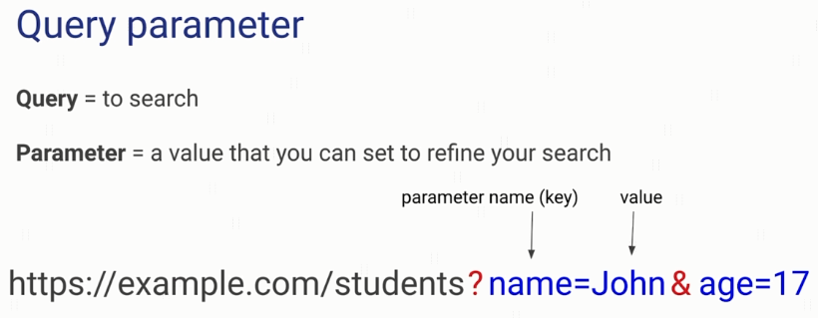

What are Query Parameters?

Slide 2
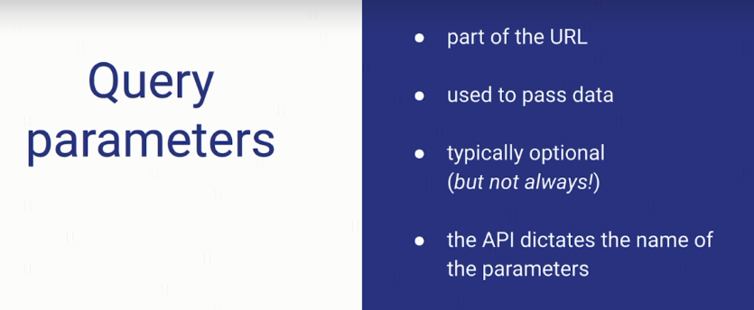
What are Query Parameters?

Slide 3
What are Query Parameters?
https://www.ecosia.org/search?q=actor
https://jobs.github.com/api

Slide 4
HTTP Message Structure
https://www.udemy.com/course/introduction-to-apis-rest-api-graphql-soap-web-services-grpc/learn/lecture/19945554#overview

